Slide 1
Schedules and Serializability
11/12/97
M-<number>

Slide 2
Concurrency
Isolation is a problem only when multiple users are accessing the same data, and their actions interleave.
Why is concurrency necessary?
  Applications demand it
  Better utilization of resources: While one user/transaction is reading the disk, another can be using the CPU or reading another disk. This results in better throughput and response time.

Slide 3
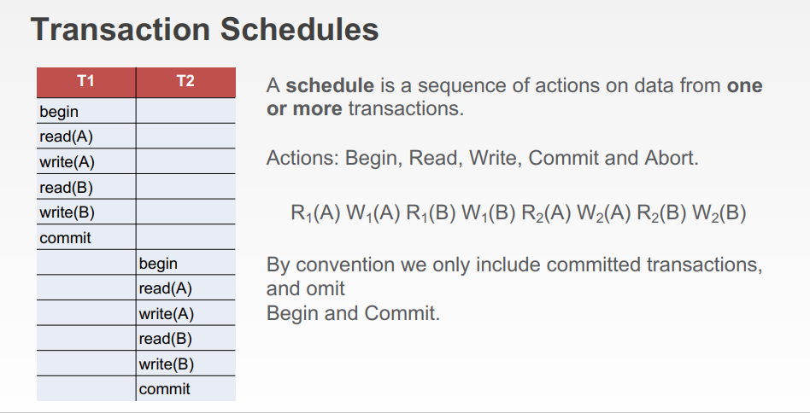
11/12/97
M-<number>

Slide 4
Schedule Notation
S_{a} A schedule of one or more transactions
T_{i} A transaction.
R_{i}(X) Transaction Ti performs a READ of data item X.
W_{i}(X) Transaction Ti performs a WRITE of data item X.
A_{i} Transaction i aborts.
C_{i} Transaction i commits.
11/12/97
M-<number>

Slide 5
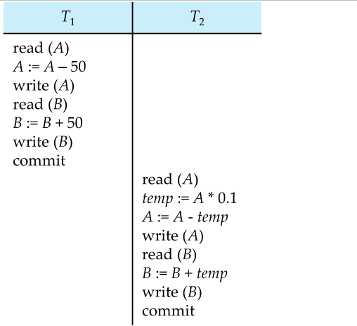
Schedules 1
Let T1 transfer $50 from A to B, and T2 transfer 10% of the balance from A to B. A serial schedule in which T1 is followed by T2 :-
M-<number>

Slide 6
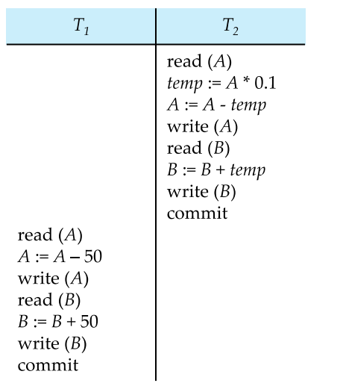
Schedules 2
A serial schedule where T2 is followed by T1
M-<number>

Slide 7
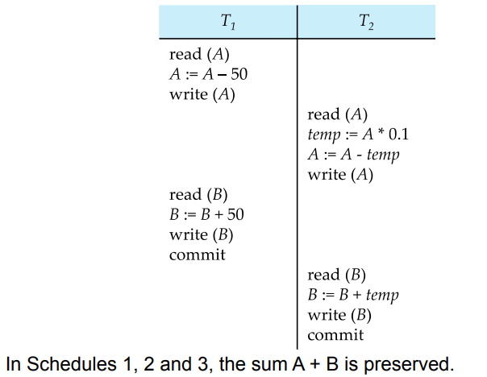
Schedules 3
Let T1 and T2 be the transactions defined previously. The following schedule is not a serial schedule, but it is equivalent to Schedule 1
M-<number>

Slide 8
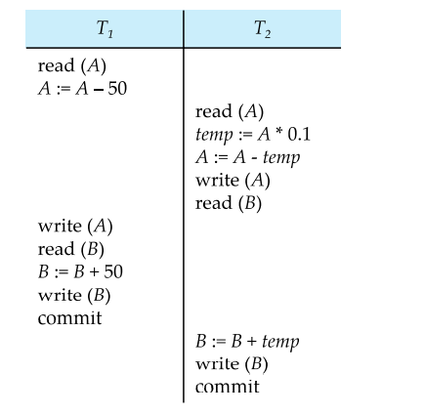
Schedules 4
The following concurrent schedule does not preserve the value of (A + B ).
M-<number>

Slide 9
Serial Schedules
Consider these transactions
T1: BEGIN A+=100, B-=100 END //Deposit, withdraw
T2: BEGIN C = A+B END //Compute bank balance
T3: BEGIN A =1.06*A, B=1.06*B //Give interest
Definition: A schedule of transactions is an interleaving of the actions of the transactions so that each transaction’s order is preserved
Definition: A schedule of transactions is serial if its transactions occur consecutively, one after another.

Slide 10
Schedule, Serial Schedules*
Which of these is a schedule of T1,T2, and/or T3? A serial schedule?
Time
S1
T1: A+=100, B-=100
T3: A=1.06*A, B=1.06*B
S2
T1: A+=100, B-=100
T3: A=1.06*A, B=1.06*B
S3
T1: A+=100, B-=100
T2: C=A+B
S4
T1: B-=100, A+=100
T2: C=A+B
Notes:
S1: A schedule of T1 and T3. Also a Serial schedule.
S2: A schedule of T1 and T3. Not a serial schedule.
S3: A Schedule of T1 and T2. Not a serial schedule.
S4: Not a schedule because T1 is not in the correct order.

Slide 11
Allowable Concurrency*
We want to allow interleaved schedules like S2&S3, otherwise the DBMS becomes a (very slow) batch system.
S2 Looks good. Why?
Any DBMS should allow S2.
What is wrong with S3? C=A+B
Any DBMS should forbid S3.
How can we distinguish between S2 and S3?
Notes:
S2 is good because S2 leaves the database in the same state as does S1, because you can perform the green actions in any order and get the same result.
S3 is bad because the Auditor C will read a false balance. C will find an extra $100 in A's account.

Slide 12
Serializable Schedules
Definition: A schedule is serializable if its effect on the DB is the same as the effect of some serial schedule.
  Clearly serial schedules like S1 are serializable
  S2 is serializable
Serializability is the same as the isolation condition of Atomicity, Consistency, Isolation, Durability (ACID).
The goal of the concurrency control subsystem of a DBMS is to ensure serializability*
First we will study the theory of serializability, then we will see how it is ensured in practice.

Slide 13
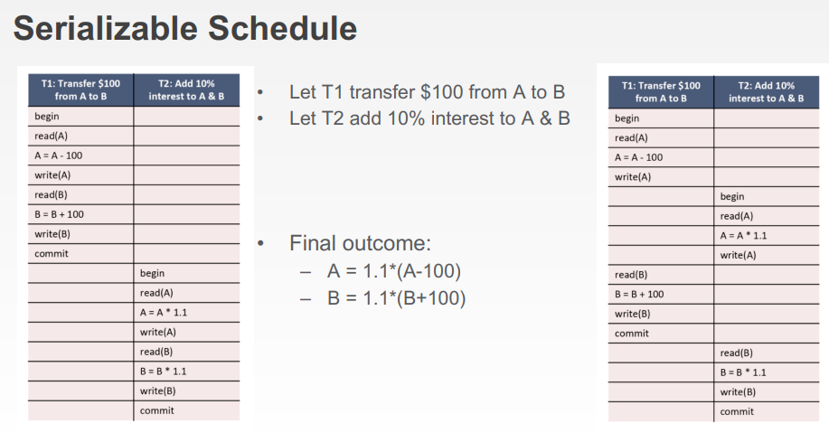
11/12/97
M-<number>

Slide 14
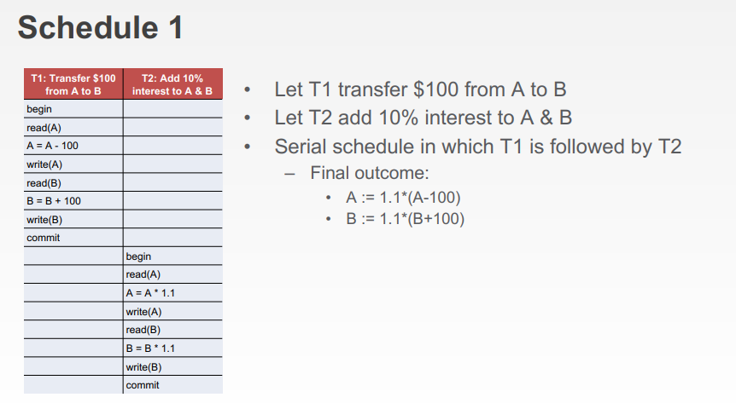
11/12/97
M-<number>

Slide 15
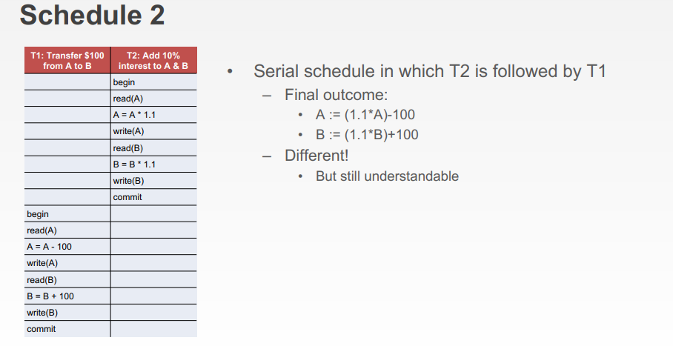
11/12/97
M-<number>

Slide 16
11/12/97
M-<number>

Slide 17
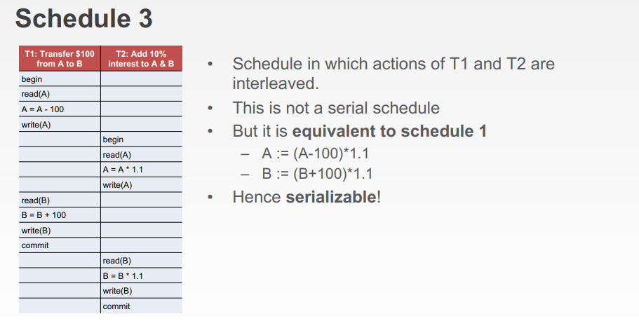
11/12/97
M-<number>

Slide 18
Conflicting Instructions (Operations)
Two operations are said to be in conflict, if they satisfy all the following three conditions:
  1. Both the operations should belong to different transactions.
  2. Both the operations are working on same data item.
  3. At least one of the operation is a write operation.
Example 1: Operation W(X) of transaction T1 and operation R(X) of transaction T2 are conflicting operations, because they satisfy all the three conditions mentioned above. They belong to different transactions, they are working on same data item X, one of the operation in write operation
Example 2: Similarly Operations W(X) of T1 and W(X) of T2 are conflicting operations.
Example 3: Operations W(X) of T1 and W(Y) of T2 are non-conflicting operations because both the write operations are not working on same data item so these operations don’t satisfy the second condition.
Example 4: Similarly R(X) of T1 and R(X) of T2 are non-conflicting operations because none of them is write operation.
Example 5: Similarly W(X) of T1 and R(X) of T1 are non-conflicting operations because both the operations belong to same transaction T1.
M-<number>

Slide 19
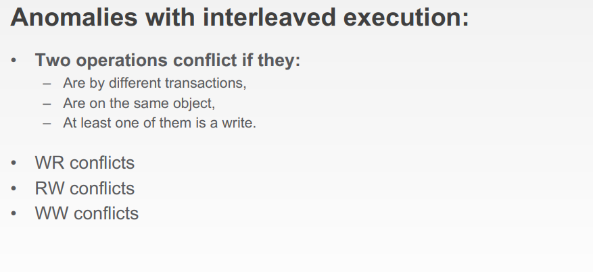
11/12/97
M-<number>

Slide 20
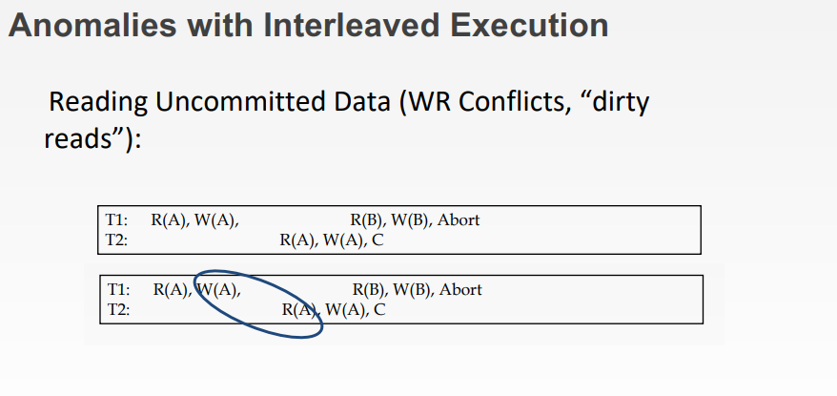
11/12/97
M-<number>

Slide 21
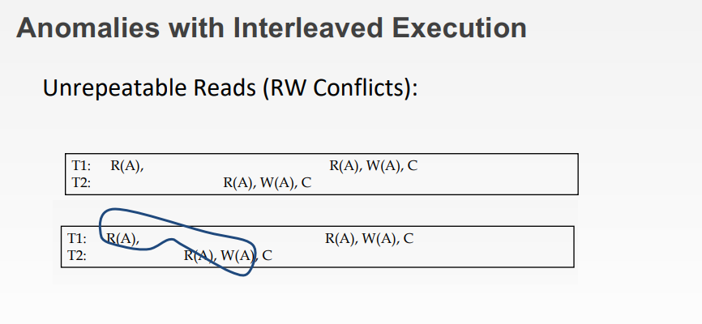
11/12/97
M-<number>

Slide 22
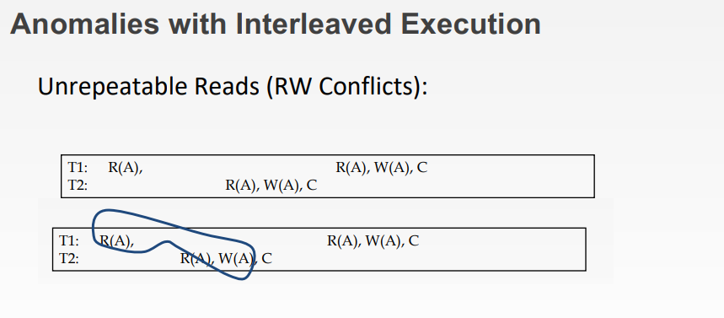
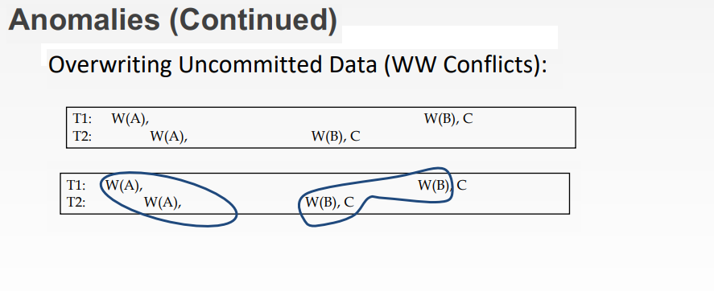
11/12/97
M-<number>

Slide 23
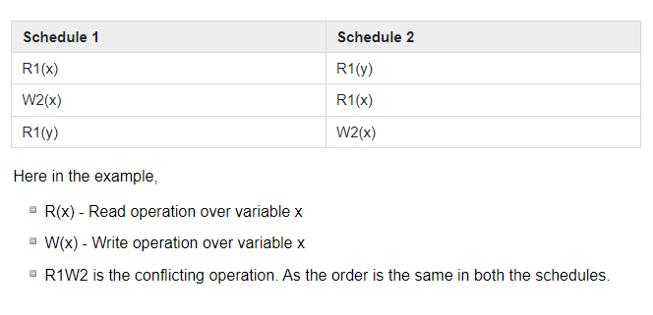
Conflict Equivalent Schedules
Two schedules are said to be conflict equivalent if the order of any two conflicting operations are the same in both the schedules
Example (conflict equivalent )
M-<number>

Slide 24
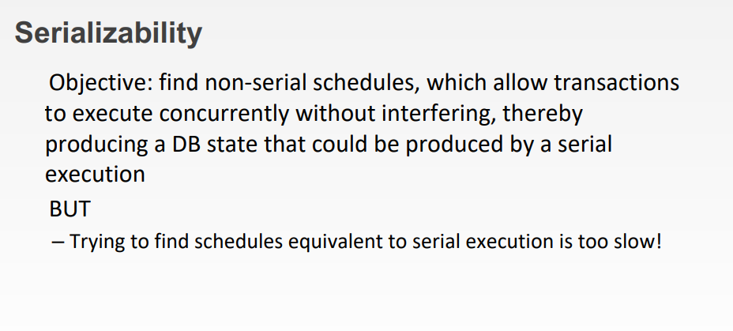
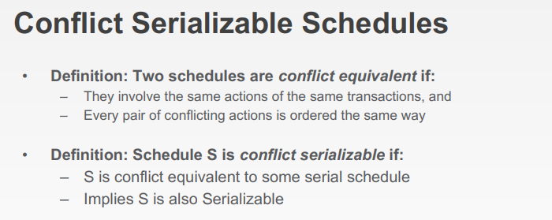
11/12/97
M-<number>

Slide 25
DBMS Conflict Serializability
Conflict Equivalent Schedules
  Two schedules are said to be conflict Equivalent if one schedule can be converted into other schedule after swapping non-conflicting operations.
Conflict Serializable Schedule
  A schedule is called conflict serializability if after swapping of non-conflicting operations, it can transform into a serial schedule.
  The schedule will be a conflict serializable if it is conflict equivalent to a serial schedule
M-<number>

Slide 26
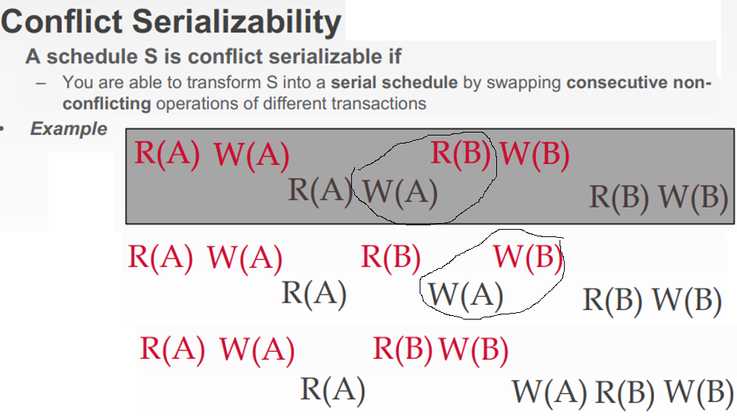
11/12/97
M-<number>

Slide 27
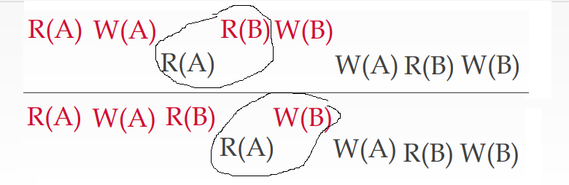
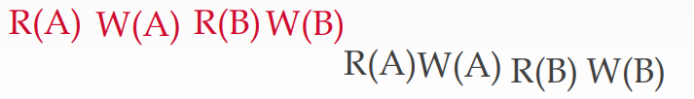
11/12/97
M-<number>

Slide 28
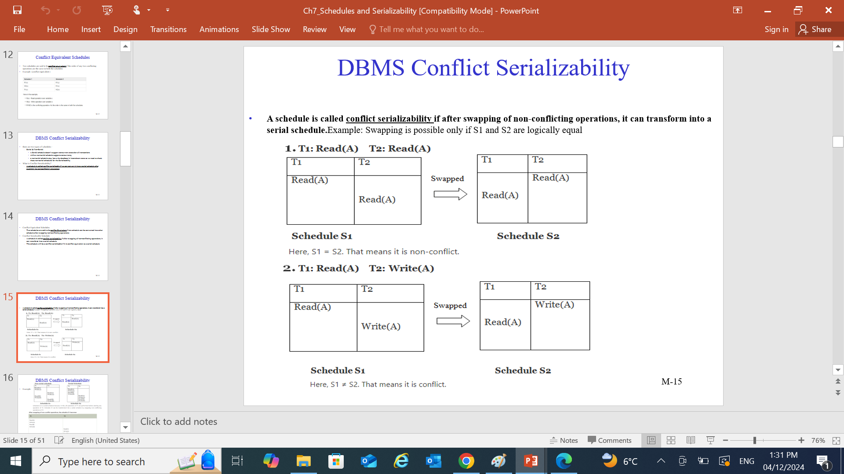
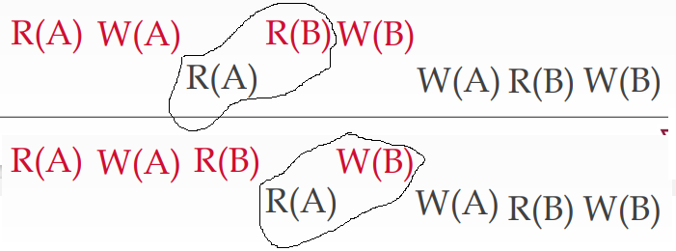
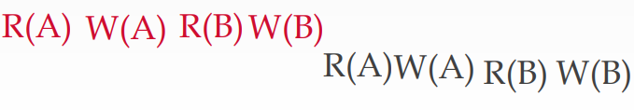
11/12/97
M-<number>

Slide 29
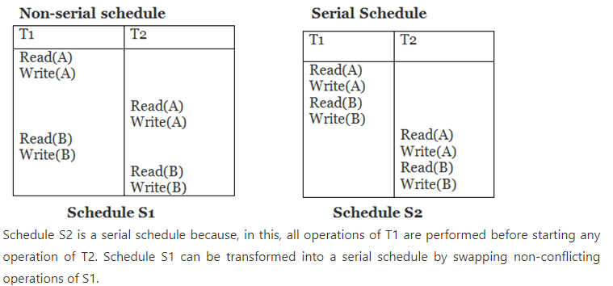
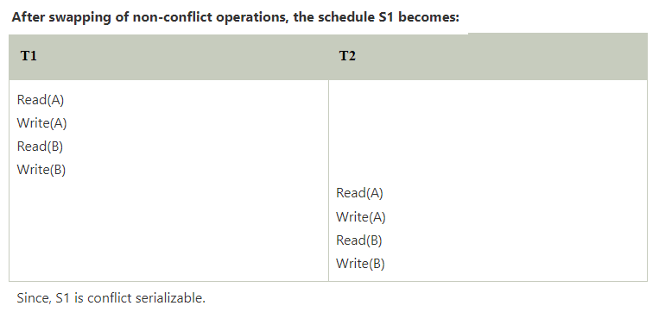
DBMS Conflict Serializability
Example:
M-<number>

Slide 30
DBMS Conflict Serializability
Example:
M-<number>

Slide 31
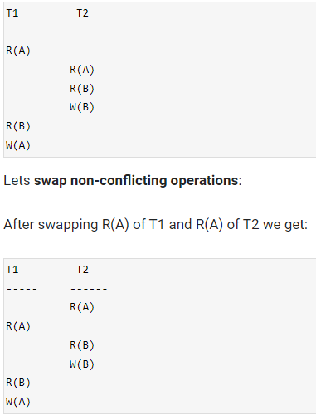
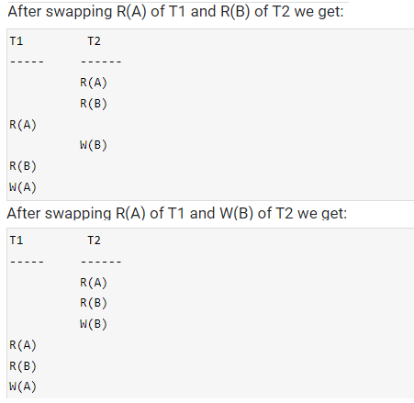
DBMS Conflict Serializability (Example)
M-<number>

Slide 32

DBMS Conflict Serializability (Example)
Consider the following schedule:
If Oi and Oj are two operations in a transaction and Oi< Oj (Oi is executed before Oj), same order will follow in the schedule as well. Using this property, we can get two transactions of schedule S1:
Possible Serial Schedules are: T1->T2 or T2->T1
-> Swapping non-conflicting operations R2(A) and R1(B) in S1, the schedule becomes,
-> Similarly, swapping non-conflicting operations W2(A) and W1(B) in S11, the schedule becomes,
S12 is a serial schedule in which all operations of T1 are performed before starting any operation of T2. Since S has been transformed into a serial schedule S12 by swapping non-conflicting operations of S1, S1 is conflict serializable
M-<number>

Slide 33
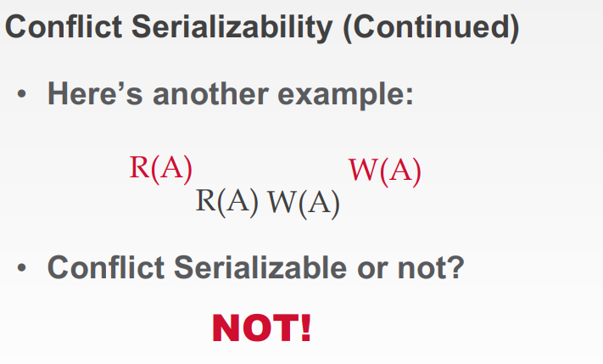
11/12/97
M-<number>

Slide 34
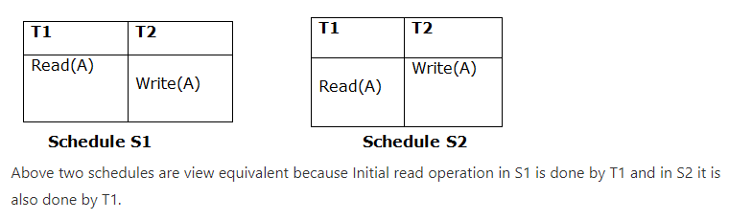
View Serializability
A schedule will view serializable if it is view equivalent to a serial schedule.
If a schedule is conflict serializable, then it will be view serializable.
The view serializable which does not conflict serializable contains blind writes.
View Equivalent
  Two schedules S1 and S2 are said to be view equivalent if they satisfy the following conditions
  1. Initial Read
    An initial read of both schedules must be the same. For example, if transaction T1 reads a data item X before transaction T2 in schedule S1 then in schedule S2, T1 should read X before T2.
M-<number>

Slide 35
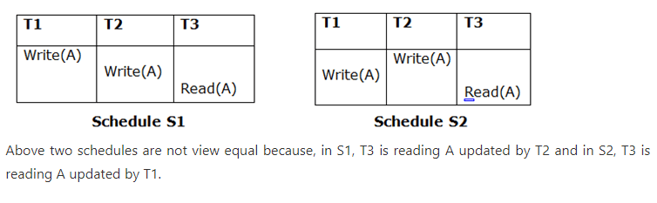
View Serializability (Cont)
View Equivalent
  2. Updated Read
    In schedule S1, if Ti is reading A which is updated by Tj then in S2 also, Ti should read A which is updated by Tj
    If in schedule S1, the transaction T1 is reading a data item updated by T2 then in schedule S2, T1 should read the value after the write operation of T2 on same data item.
    For example, In schedule S1, T1 performs a read operation on X after the write operation on X by T2 then in S2, T1 should read the X after T2 performs write on X.
M-<number>

Slide 36
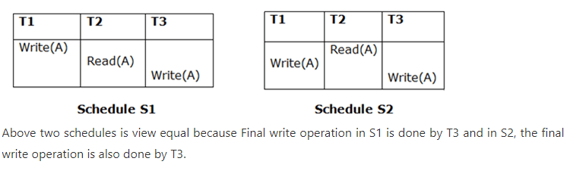
View Serializability (Cont)
View Equivalent
  3. Final Write
  A final write must be the same between both the schedules. In schedule S1, if a transaction T1 updates A at last then in S2, final writes operations should also be done by T1.
  For example, a data item X is last written by Transaction T1 in schedule S1 then in S2, the last write operation on X should be performed by the transaction T1.
M-<number>

Slide 37
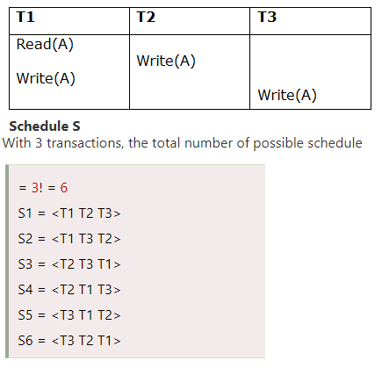



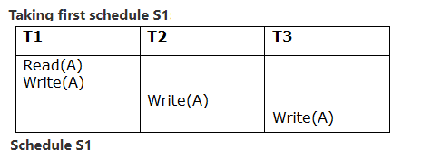

View Serializability (Cont)
Example
M-<number>

Slide 38
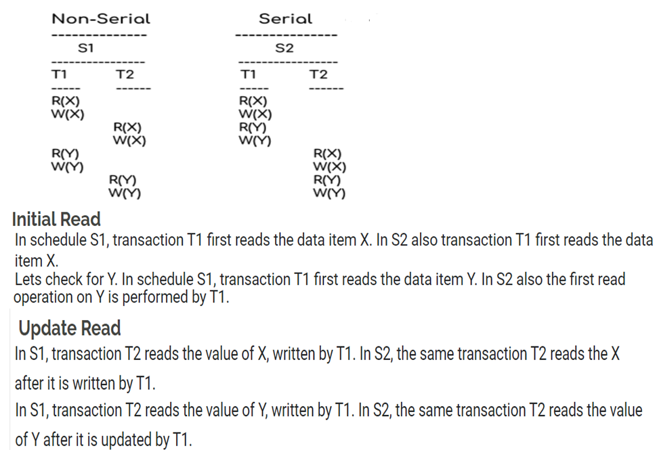
View Serializability (Cont)
11/12/97
M-<number>

Slide 39
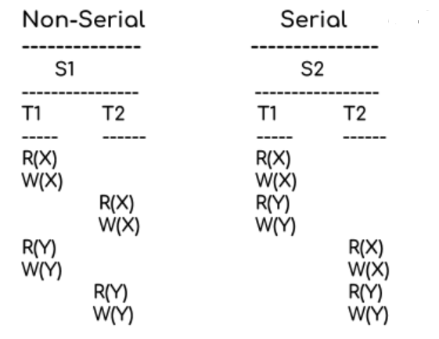
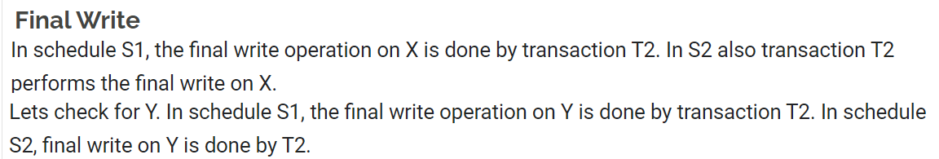
View Serializability (Cont)
M-<number>

Slide 40
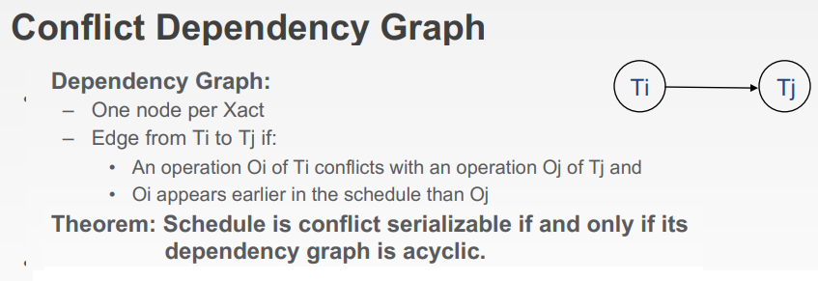
DBMS Testing of Serializability
Serialization Graph is used to test the Serializability of a schedule.
following steps:
  Step 1: We will find and list all of the operations that are in conflict.
  Step 2: Then we will draw one node for each transaction in a precedence graph.
  Step 3: After that, we will draw an edge from Ti to Tj for each conflict pair, so that if Xi (V) and Yj (V) form a conflict pair, draw an edge from Ti to Tj. This ensured that Ti is executed before Tj.
  otherwise, it is not.
M-<number>

Slide 41
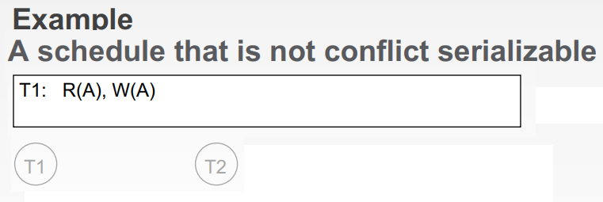
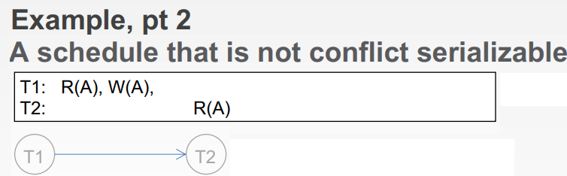
11/12/97
M-<number>

Slide 42
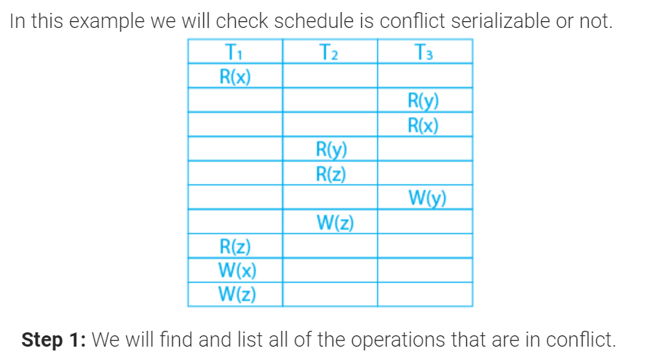
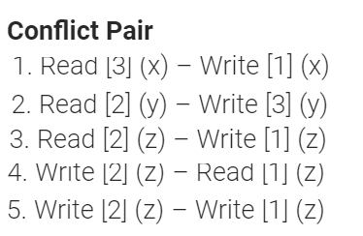
DBMS Testing of Serializability
M-<number>

Slide 43
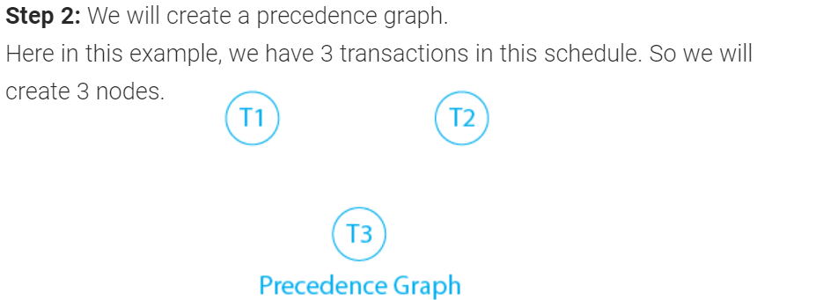
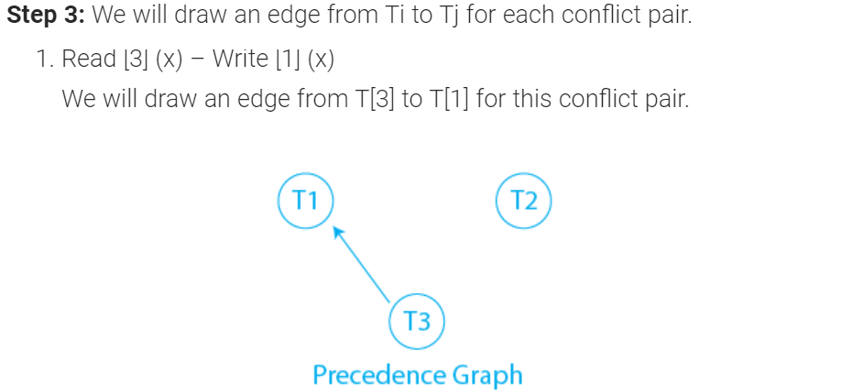
DBMS Testing of Serializability
M-<number>

Slide 44
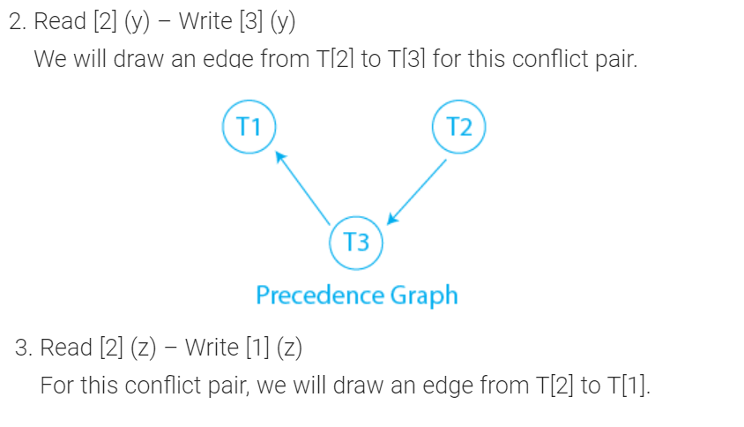
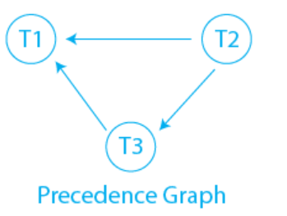
DBMS Testing of Serializability
M-<number>

Slide 45
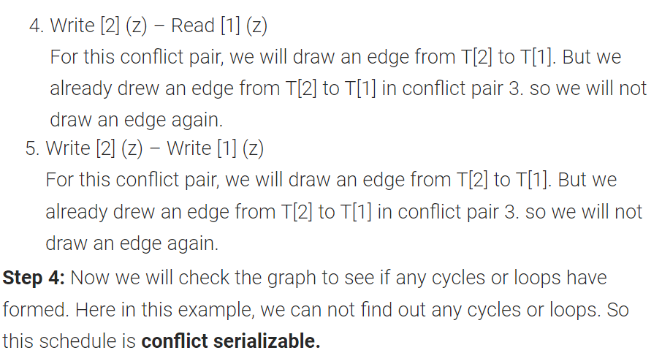
DBMS Testing of Serializability
M-<number>

Slide 46
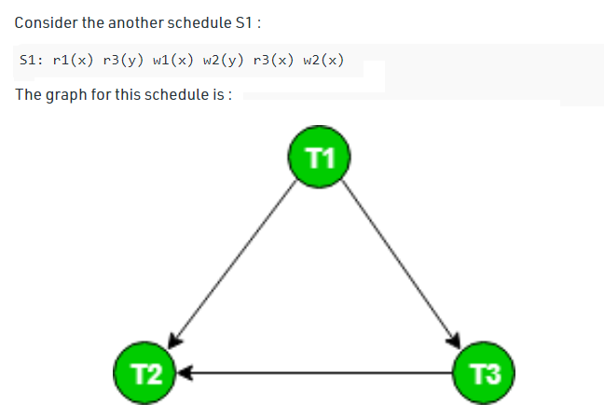


DBMS Testing of Serializability
M-<number>

Slide 47
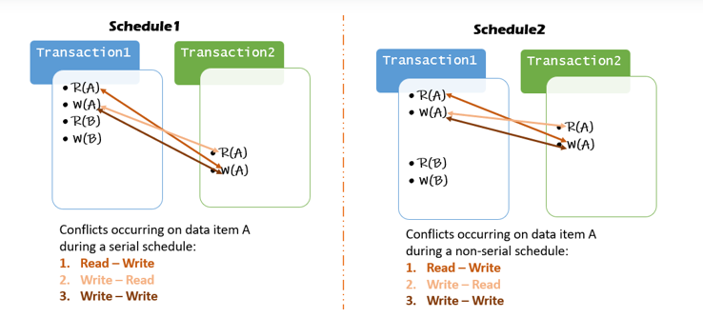
DBMS Testing of Serializability
M-<number>

Slide 48
DBMS Recoverability of Schedule
Sometimes a transaction may not execute completely due to a software issue, system crash or hardware failure.
The failed transaction has to be rollback.
But some other transaction may also have used value produced by the failed transaction.
So we also have to rollback those transactions.
M-<number>

Slide 49
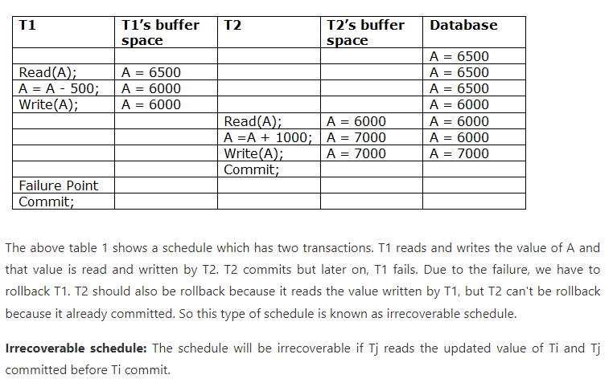
DBMS Recoverability of Schedule
M-<number>

Slide 50
DBMS Recoverability of Schedule
CASCADE is used to simultaneously delete or update an entry from both the child and parent table.
CASCADE is used as a conjunction while writing the query of ON DELETE or ON UPDATE
  CREATE TABLE Mathematics( Enrollment INT, Student_Name varchar(20), Marks INT, PRIMARY KEY(Enrollment, Student_Name),
  FOREIGN KEY(Enrollment) REFERENCES Class(Enrollment) ON DELETE CASCADE ON UPDATE CASCADE
  );
M-<number>

Slide 51
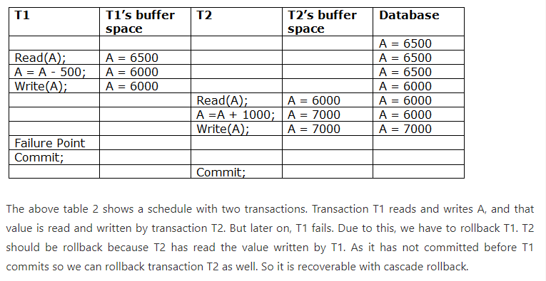
DBMS Recoverability of Schedule
M-<number>

Slide 52

DBMS Recoverability of Schedule
M-<number>

Slide 53

DBMS Recoverability of Schedule
M-<number>

Slide 54


DBMS Recoverability of Schedule
M-<number>

Slide 55
Deadlock in DBMS
A deadlock is a condition where two or more transactions are waiting indefinitely for one another to give up locks.
Deadlock is said to be one of the most feared complications in DBMS as no task ever gets finished and is in waiting state forever.
For example: In the student table, transaction T1 holds a lock on some rows and needs to update some rows in the grade table. Simultaneously, transaction T2 holds locks on some rows in the grade table and needs to update the rows in the Student table held by Transaction T1.
Now, the main problem arises. Now Transaction T1 is waiting for T2 to release its lock and similarly, transaction T2 is waiting for T1 to release its lock. All activities come to a halt state and remain at a standstill. It will remain in a standstill until the DBMS detects the deadlock and aborts one of the transactions.
M-<number>

Slide 56

Deadlock in DBMS
M-<number>

Slide 57
Deadlock in DBMS
Deadlock Avoidance
  When a database is stuck in a deadlock state, then it is better to avoid the database rather than aborting or restating the database.
  This is a waste of time and resource.
  Deadlock avoidance mechanism is used to detect any deadlock situation in advance.
  A method like "wait for graph" is used for detecting the deadlock situation but this method is suitable only for the smaller database.
M-<number>

Slide 58

DBMS Cascading Rollbacks
If in a schedule, failure of one transaction causes several other dependent transactions to rollback or abort, then such a schedule is called as a Cascading Schedule or Cascading Rollback or Cascading Abort.
It simply leads to the wastage of CPU time.
M-<number>

Slide 59

DBMS Cascading Rollbacks
M-<number>

